Slide 1
AZ-900T01 Module 02: Core Azure services

Slide 2
Lesson 01: Learning objectives

Slide 3
Module 2 – Learning objectives
Understand and describe core Azure architectural components
Understand and describe core Azure services and products
Understand and describe Azure solutions
Understand and describe Azure management tools

Slide 4
Lesson 02: Core Azure architectural components

Slide 5
Regions
Azure is made up of datacenters located around the globe. These datacenters are organized and made available to end users by country/region
In reference to datacenters, a region is a geographical area on the planet containing at least one—but potentially multiple —datacenters that are in close proximity and networked together with a low-latency network
Notes:
A list of regions and their locations is available at https://azure.microsoft.com/en-us/global-infrastructure/locations/
In the context of this course, this is what we mean by "region”.
Microsoft Azure has more global regions than any other cloud provider. This provides customers the flexibility and scale needed to bring applications closer to users around the world, preserving data residency and offering comprehensive compliance and resiliency options for customer. At the time of writing this, Azure is generally available in 42 regions around the world, with plans announced for 12 additional regions.
Special Azure regions
Special regions include:
US DoD Central, US Gov Virginia, US Gov Iowa and more in the US. These are physical and logical network-isolated instances of Azure for US government agencies and partners. They are operated by screened US personnel. Includes additional compliance certifications.
China East, China North, and more in China. These regions are available through a unique partnership between Microsoft and 21Vianet, whereby Microsoft does not directly maintain the datacenters.
Germany Central and Germany Northeast. These regions are available through a data trustee model whereby customer data remains in Germany under control of T-Systems, a Deutsche Telekom company.

Slide 6

Regions - continued
Azure special regions
For applications with specific compliance or legal requirements.
Azure Government (North America)
Azure China 21Vianet
Azure Germany
Region pairs
Each Azure region is paired with another region, within the same geography. Pairing replicates Azure resources to minimize service interruptions from natural disasters, power or network outages.
Notes:
Special Azure regions include:
North America - US DoD Central, US Gov Virginia, US Gov Iowa, and more in the US. These are physical and logical network-isolated instances of Azure for US government agencies and partners. They are operated by screened US personnel, and require strict compliance certifications.
Asia - China East, China North, and more in China. These regions are available through a unique partnership between Microsoft and 21 Vianet. Microsoft does not directly maintain these data centers.
Europe - Germany Central and Germany Northeast. These regions are available through a data trustee model. Customer data remains in Germany, under control of T-Systems (a Deutsche Telekom company).
Additional advantages of region pairs include:
In the event of a wider Azure outage, one region out of every pair is prioritized to help reduce the time it takes to restore them for applications.
Planned Azure updates are rolled out to paired regions one region at a time to minimize downtime and risk of application outage.
Data continues to reside within the same geography as its pair (except for Brazil South) for tax and law enforcement jurisdiction purposes.
Examples of region pairs would be West US paired with East US, and Southeast Asia paired with East Asia.
Note: A full list of region pairs is available at https://docs.microsoft.com/en-us/azure/best-practices-availability-paired-regions#what-are-paired-regions

Slide 7
Geographies
Discrete markets that preserve data residency and compliance boundaries.
Geography features:
Typically contain two or more regions.
Allow customers with specific data-residency and compliance needs to keep their data and applications in close proximity.
Categorized as Americas, Europe, Asia Pacific, Middle East, and Africa.
Notes:
A list of geography locations is available at : https://azure.microsoft.com/en-us/global-infrastructure/geographies/

Slide 8
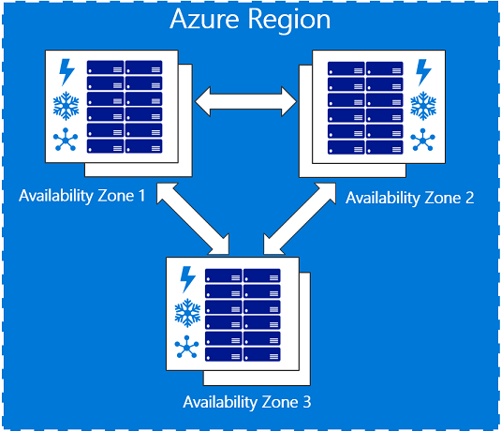
Availability zones
Physically separate locations within an Azure region.
Made up of one or more datacenters, equipped with independent power, cooling, and networking.
Act as an isolation boundary.
If one availability zone goes down, the other continues working.
Notes:
The availability zones are typically connected to each other through very fast, private fiberoptic networks.
Availability zones allow customers to run mission-critical applications with high availability and low-latency replication.
Availability zones are offered as a service within Azure, and to ensure resiliency, there’s a minimum of three separate zones in all enabled regions.
More details about Availability Zones in Azure are available at https://docs.microsoft.com/en-us/azure/availability-zones/az-overview

Slide 9
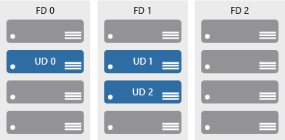
Availability sets
Keep applications online during maintenance or hardware failure.
Comprised of:
Update domains (UD): Scheduled maintenance, performance or security updates are sequenced through update domains.
Fault domains (FD): Provide a physical separation of workloads across different hardware in a data center.

Slide 10
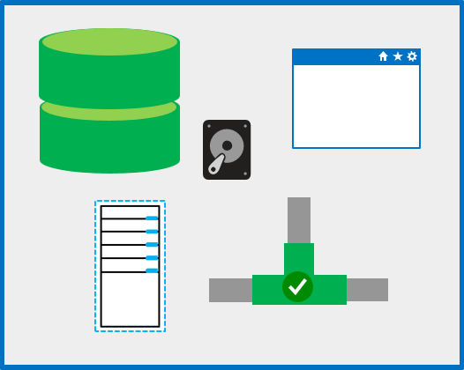
Resource groups
A unit of management for resources in Azure.
Resource group features:
Act as containers to aggregate the resources required by an application into a single, manageable unit.
Every Azure resource must exist in one (and only one) Resource Group.
Notes:
Think of a resource group as a container that allows you to aggregate and manage all the resources required by your application, in a single manageable unit.
Every resource created in Azure must exist in one and only one Resource Group.

Slide 11
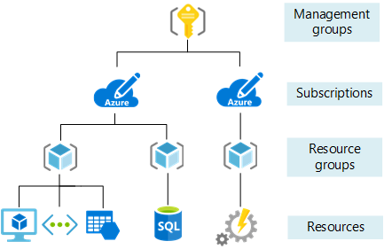
Azure Resource Manager
Provides a management layer in which resource groups and all the resources within it are created, configured, managed, and deleted
With Azure Resource Manager, you can:
Create, configure, manage and delete resources and resource groups
Organize resources
Control access and resources
Automate using different tools and SDKs
Notes:
Azure Resource Manager, provides a consistent management layer that allows you to automate deployment and configuration of resources using different automation and scripting tools, such as Microsoft Azure PowerShell, Azure Command-Line Interface (Azure CLI), Azure portal, REST API, and client software development kits (SDKs).
You can view more details about Azure Resource Manager at https://docs.microsoft.com/en-us/azure/azure-resource-manager/resource-group-overview

Slide 12
Lesson 03: Core Azure services and products

Slide 13
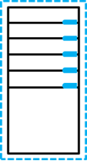
Azure compute services
On-demand computing service for running cloud-based applications.
Azure compute services features:
provides computing resources such as disks, processors, memory, networking, and operating systems.
makes resources available in minutes or seconds.
pay-per-use.
common on-demand Azure services are : (a) Virtual Machines, and (b) Containers.
Notes:
For a full list of compute services available with Azure and the context on when to use them, visit https://azure.microsoft.com/en-us/product-categories/compute/

Slide 14

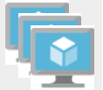
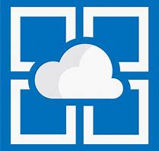

Azure compute services - virtual machine services
VMs are software emulations of physical computers. Examples of Azure services for virtual machines include:
Azure VMs: Infrastructure as a service (IaaS) to create and use VMs in the cloud
VM scale sets: Designed for automatic scaling of identical VMs
App services: Platform as a service (PaaS) offering to build, deploy, and scale enterprise-grade web, mobile, and API apps
Functions: Creates infrastructure based on an event
Notes:
Azure VMs
Azure virtual machines (VMs) let you create and use virtual machines in the cloud. It provides infrastructure as a service (IaaS) and can be used in a variety of different ways. When you need total control over an operating system and environment, Azure VMs are an ideal choice. See https://azure.microsoft.com/en-us/services/virtual-machines/ for more details.
VM scale sets
VM scale sets are an Azure compute resource that you can use to deploy and manage a set of identical VMs. With all VMs configured the same, VM scale sets are designed to support true auto-scale—no pre-provisioning of VMs is required.. See https://azure.microsoft.com/en-us/services/virtual-machine-scale-sets/for more details.
App Services
With App Services, you can quickly build, deploy, and scale enterprise-grade web, mobile, and API apps running on any platform. You can meet rigorous performance, scalability, security and compliance requirements while using a fully managed platform to perform infrastructure maintenance. App Services is a platform as a service (PaaS) offering. See https://azure.microsoft.com/en-us/services/app-service/ for more details.
Functions
When you're concerned only about the code running your service and not the underlying platform or infrastructure, Azure Functions are ideal. They're commonly used when you need to perform work in response to an event (often via a REST request), timer, or message from another Azure service, and when that work can be completed quickly, within seconds or less. See https://azure.microsoft.com/en-us/services/functions/ for more details.

Slide 15
Demo: Create an Azure virtual machine

Slide 16
Walkthrough-Create a Virtual machine using Azure Portal
In this walkthrough task we will create a virtual machine in Azure via the Azure Portal, configure it as a web server and connect to the web server over the internet.
You can complete this walkthrough task by completing the steps outlined below, or you can simply read through them, depending on your available time
Notes:
Students can just read through the tasks and get a feel for how they work or actually step through them like a lab task.
Another option could be to complete the walkthrough at the end of the module, and complete all or some of the walkthroughs in the module together at that stage, like an end of module or even end of course lab.
Prerequisites
You require need an Azure subscription to perform these steps. If you don't have one you can create one by following the steps outlined on the Create your Azure free account today webpage.
Steps
1. Sign in to the Azure portal at https://portal.azure.com
2. Choose Create a resource in the upper left-hand corner of the Azure portal.
3. In the search box above the list of Azure Marketplace resources, search for and select Windows Server 2016 Datacenter, then choose Create.
4. In the Basics tab, under Project details, make sure the correct subscription is selected and then choose to Create new resource group. Type myResourceGroup for the name.
5. Under Instance details, type myVM for the Virtual machine name and choose East US for your Location. Leave the other defaults.
6. Under the Administrator account section, provide a username, such as azureuser and a password. The password must be at least 12 characters long and meet the defined complexity requirements.
7. Under Inbound port rules, choose Allow selected ports and then select RDP (3389) and HTTP (80) from the drop-down. These are to allow us to connect to the virtual machine using RDP over port 3389 and then to see a web page display over HTTP on port 80.
8. Go to the Management tab and under the Monitoring section under Boot diagnostics select Off
9. Leave the remaining defaults and then select the Review + create button at the bottom of the page.
10. Once Validation is passed click the Create button. It can take approx three to five minutes to deploy the virtual machine.
11. Once the virtual machine is created, go to the resource group you placed the virtual machine in, and open up the virtual machine, then click the Connect button on the virtual machine properties page.
Note: The following directions tell you how to connect to your VM from a Windows computer. On a Mac, you need an RDP client such as this Remote Desktop Client from the Mac App Store and on Linux virtual machine you could connect directly from a bash shell using ssh.
12. In the Connect to virtual machine page, keep the default options to connect by DNS name over port 3389 and click Download RDP File.
13. Open the downloaded RDP file and click Connect when prompted.
14. In the Windows Security window, select More choices and then Use a different account. Type the username as localhost\username, (you could also type .\azureuser) enter password you created for the virtual machine, and then click OK.
15. You may receive a certificate warning during the sign-in process. Click Yes or to create the connection and connect to your deployed VM. You should connect successfully.
Congratulations! You have deployed and connected to a Windows Server virtual machine in Azure
If you wish and have time you could also make the deployed server a functioning web server and make a web page available publicly, by continuing with the following steps
16. Open up a PowerShell command prompt on the virtual machine, by clicking the Start button, typing PowerShell right clicking Windows PowerShell in the menu and selecting Run as administrator
17. Install the Web-Server feature in the virtual machine by running the following command in the PowerShell command prompt: PowerShell
Install-WindowsFeature -name Web-Server -IncludeManagementTools
18. When completed you should see a prompt stating Success with a value True, among other items in the output. You do not need to restart the virtual machine to complete the installation. Close the RDP connection to the VM.
19. Back in the portal, select the VM and in the overview pane of the VM, use the Click to copy button to the right of the IP address to copy it and paste it into a browser tab.
20. The default IIS Web Server welcome page will open, and is available to connect to publicly via this IP address, or via the fully qualified domain name.
Congratulations! You have created a web server that can be connected to publicly via this IP address, or via the fully qualified domain name. If you had a web page to host you could deploy those source files to the virtual machine and host them for public access on the deployed virtual machine.
Note: Remember to remove any newly created Azure resources that you no longer use. Removing unused resources ensures you will not incur unexpected costs. Remove unused resources by deleting the Resource Group that the unused resources belong to.

Slide 17
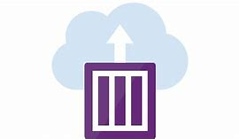
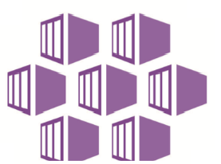
Azure compute services – container services
Containers are a virtualization environment. However, unlike virtual machines, they do not include an operating system. Containers are meant to be lightweight, and are designed to be created, scaled out, and stopped dynamically. Examples of Azure services for containers include:
Azure Container Instances: A PaaS offering that allows you to upload your containers, which it then will run for you
Azure Kubernetes Service: A container orchestrator service for managing large numbers of containers
Notes:
Azure Container Instances
Azure Container Instances offers the fastest and simplest way to run a container in Azure without having to manage any virtual machines or adopt any additional services. It’s a PaaS offering that allows you to upload your containers, which it will run for you. See https://azure.microsoft.com/en-us/services/container-instances/for more details.
Azure Kubernetes Service
The task of automating and managing a large number of containers and how they interact is known as orchestration. Azure Kubernetes Service (AKS) is a complete orchestration service for containers with distributed architectures and large volumes of containers. See https://azure.microsoft.com/en-us/services/kubernetes-service/ for more details.

Slide 18
Demo: Deploy Azure Container Instances (ACI) in Azure Portal.

Slide 19
Walkthrough-Deploy Azure Container Instances (ACI) in Azure Portal
In this walkthrough, you will create, configure, and deploy a Docker container to *Azure Container Instances* (ACI) in Azure Portal. The container is created from an image template called microsoft/aci-helloworld. The image packages a small web application, written in Node.js, and serves a static HTML page
You can complete this walkthrough task by completing the steps outlined below, or you can simply read through them, depending on your available time
Notes:
Students can just read through the tasks and get a feel for how they work or actually step through them like a lab task.
Another option could be to complete the walkthrough at the end of the module, and complete all or some of the walkthroughs in the module together at that stage, like an end of module or even end of course lab.
Prerequisites
An active Azure subscription is required. If you do not have an Azure subscription, create a free Azure account before you begin.
Steps
1. To create a new Azure Container Instance, sign in to the Azure Portal and locate the Azure Container Instance service, then select Create, or alternatively, click on the Deploy to Azure button to go to the url https://portal.azure.com/#create/microsoft.containerinstances
and when prompted, sign into Azure Portal.
2. Provide the following basic details for the new container instance. The UI you encounter may be slightly different compared to the screenshots in this walkthrough, depending on if you accessed the Create New Container Instance via the Azure portal or via the Deploy to Azure button above, however the details provided will be the same.
Container name: mycontainer
Container image type: Public
Container image: microsoft/aci-helloworld
Subscription: Choose your subscription.
Resource group: Select Create new, then type myResourceGroup, and select OK.
Location: Use the dropdown to choose the Azure region that is closest to you.
Press the OK button.
3. Configure the new container instance as follows.
DNS name label: Specify a DNS name label for your container. The DNS name label you specify must be unique within the Azure region where you create the container instance. Your container will be publicly reachable at http://<dns-name-label>.<region>.azurecontainer.io. If you receive a DNS name label not available error message, specify a different DNS name label.
Leave all other settings in the Configuration pane at their default values.
Select OK to start the automatic validation process.
4. When the validation process has passed, review the configuration summary, and select the OK button to begin deploying the container.
5. When the deployment starts, a notification appears in Azure Portal indicating the deployment is in progress. Another notification is displayed when the container deployment has completed successfully. Wait for the deployment succeeded notification before going to Step 6.
6. Obtain the Fully Qualified Domain Name (FQDN), in Azure Portal, by opening the Overview pane for the container group and navigating to Resource Groups > myResourceGroup > mycontainer. Make a note of the FQDN of the container instance, as well its Status.
7. When the Status value of the container instance is Running, navigate to the container's FQDN in a web browser.
Note: You can also navigate to the container's IP address in your browser. You can obtain the IP address by following Step 6, and making a note of the IP address instead of the FQDN.
Congratulations! You have used Azure Portal to deploy an application to a container in Azure Container Instances successfully.
Note: Remember to remove any newly created Azure resources that you no longer use. Removing unused resources ensures you will not incur unexpected costs. Remove unused resources by deleting the Resource Group that the unused resources belong to.

Slide 20
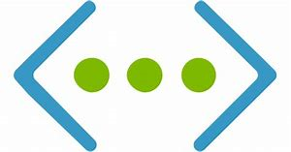
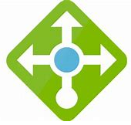


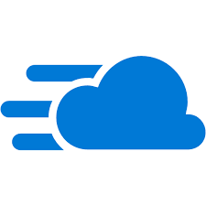
Azure network services
Networking on Azure allows you to connect cloud and on-premises infrastructure and services.
Azure Virtual Network: Provides secure communication between Azure resources
Azure Load Balancer: Allows for the management of traffic to and from applications and services.
VPN Gateway: Provides for secure traffic between Azure Virtual Networks and on-premises locations over the public internet
Azure Application Gateway: Provides for the management of traffic to web applications
Content Delivery Network: Provides for efficient delivery of web content to geographically dispersed users.
Notes:
Azure Virtual Network
Azure Virtual Network enables many types of Azure resources such as Azure VMs to securely communicate with each other, the internet, and on-premises networks. A virtual network is scoped to a single region; however, multiple virtual networks from different regions can be connected together using virtual network peering. See https://azure.microsoft.com/en-us/services/virtual-network/ for more details.
Azure Load Balancer
Azure Load Balancer can provide scale for your applications and create high availability for your services. See https://azure.microsoft.com/en-us/services/load-balancer/ for more details.
VPN gateway
A VPN gateway (also referred to as a virtual network gateway) is a more specific type of virtual network gateway that sends encrypted traffic between an Azure Virtual Network and an on-premises location over the public internet. It provides a more secure connection from on-premises to Azure over the internet. See https://azure.microsoft.com/en-us/services/vpn-gateway/for more details.
Azure Application Gateway
Azure Application Gateway is a web traffic load balancer that enables you to manage traffic to your web applications. It is the connection through which users connect to your application.. See https://azure.microsoft.com/en-us/services/application-gateway/ for more details.
Content Delivery Network
A content delivery network (CDN) is a distributed network of servers that can efficiently deliver web content to users. It is a way to get content to users in their local region to minimize latency. CDN can be hosted in Azure or any other location. See https://azure.microsoft.com/en-us/services/cdn/ for more details.
For a full list of networking services available with Azure, and context on when you use them, see https://azure.microsoft.com/en-us/product-categories/networking/

Slide 21
Walkthrough-Create a virtual network via the Azure Portal
In this walkthrough task we will create a virtual network, deploy two virtual machines onto that virtual network and then configure them to allow one virtual machine to ping the other over that virtual network.
You can complete this walkthrough task by completing the steps outlined below, or you can simply read through them, depending on your available time
Notes:
Students can just read through the tasks and get a feel for how it works or actually step through it like a lab task.
Another option could be to complete the walkthrough at the end of the module, and complete all or some of the walkthroughs in the module together at that stage, like an end of module or even end of course lab.
Prerequisites
You require need an Azure subscription to perform these steps. If you don't have one you can create one by following the steps outlined on the Create your Azure free account today webpage.
Steps
1. Sign in to the Azure portal at https://portal.azure.com
2. Choose Create a resource in the upper left-hand corner of the Azure portal, then select Networking > Virtual network
3. In the Create virtual network pane above the list of Azure Marketplace resources, search for and select Windows Server 2016 Datacenter, then choose Create using the following settings and values.
Name=vnet1
Address space=10.1.0.0/16
Subscription=< Select your subscription >
Resource group= Select Create new, enter vnet1-rg1, then select OK.
Location=East US
Subnet – Name= subnet1
Subnet Address range=10.1.0.0/24
Leave the rest of the settings at their default values and select Create.
4. Verify the creation of the virtual network by going to the newly created resource group and viewing the virtual network is present, you can click on the virtual network and view its properties if you wish.
5. Create a virtual machine by going to the the upper-left side of the Azure Portal and selecting Create a resource > Compute > Windows Server 2016 Datacenter
6. In Create a virtual machine - Basics tab, enter or select this information:
Subscription=< Select your subscription >
Resource group=The resource group you created it in the last section, i.e. vnet1-rg1
Virtual machine name=vm1
Region=East US
Availability options=Leave the default No infrastructure redundancy required
Image=Leave the default Windows Server 2016 Datacenter
Size=Leave the default Standard DS1 v2
Username=azureuser
Password=enter a password that meets the complexity requirements.
Public inbound ports=Select Allow selected ports
Selected inbound ports=Select HTTP, HTTPS, SSH and RDP
7. Select Next : Disks, leave the default values.
8. Select Next : Networking, complete the following details
Virtual network=Leave the default vnet1
Subnet=Leave the default subnet1 (10.1.0.0/24)
Public IP=Leave the default (new) vm1-ip
NIC network security group=accept the default Basic
Public inbound ports=Select Allow selected ports
Select inbound ports=Select HTTP, HTTPS, SSH and RDP
9. Select Next : Management, accept all the defaut values except for the below settings:
Boot diagnostics=accept the default value i.e. On
Diagnostic storage account=accept the default value i.e. vnet1rgdiag
10. Select Review + create. Azure will validate the configuration. When you see that Validation passed, select Create. Deployment times can vary but it can generally take between three to six minutes to deploy.
11. Create a second Virtual machine by repeating steps 5 to 9 above, using the same values above above ensuring the below settings are set:
Virtual machine name=vm2
Public IP=Leave the default (new) vm2-ip
Diagnostic storage account=Leave the default value i.e. vnet1rg1diag
12. When finished filling in the details, validate the configuration by clicking Review + create and once successfully validated click Create
13. When both virtual machine have completed deployment connect to the first virtual machine, vm1, by going to the resource group you placed the virtual machine in, vnet-rg1 and open up the virtual machine, then click the Connect button on the virtual machine properties page.
Note: The following directions tell you how to connect to your VM from a Windows computer. On a Mac, you need an RDP client such as this Remote Desktop Client from the Mac App Store and on Linux virtual machine you could connect directly from a bash shell using ssh.
14. In the Connect to virtual machine page, keep the default options to connect by DNS name over port 3389 and click Download RDP File.
15. Open the downloaded RDP file and click Connect when prompted.
16. In the Windows Security window, select More choices and then Use a different account. Type the username as localhost\username, (you could also type .\azureuser) enter password you created for the virtual machine, and then click OK.
17. You may receive a certificate warning during the sign-in process. Click Yes or to create the connection and connect to your deployed VM. You should connect successfully.
18. Open up a PowerShell command prompt on the virtual machine, by clicking the Start button, typing PowerShell right clicking Windows PowerShell in the menu and selecting Run as administrator
19. Run the command ping vm2
You receive an error, saying request timed out. The ping fails, because ping uses the Internet Control Message Protocol (ICMP). By default, ICMP isn't allowed through the Windows firewall.
20. To allow vm2 to ping vm1 enter the below command. This command allows ICMP inbound through the Windows firewall:
New-NetFirewallRule –DisplayName “Allow ICMPv4-In” –Protocol ICMPv4
21. Connect to VM2 as has been done for VM1, using rdp. i.e. open vm2 properties and click the Connect button to download and then connect vis RDP
22. Open up a PowerShell command prompt on the virtual machine, VM2, and run the command:
ping vm1 You should now be able to ping the vm1 virtual machine successfully, because ICMP has been configured to be allowed through the Windows firewall on the vm1 virtual machine in an earlier step.
Congratulations! This ping is being done using the virtual network you created and deployed the two virtual machines into. The two virtual machines are communicating over this virtual network that was created.
Note: Remember to remove any newly created Azure resources that you no longer use. Removing unused resources ensures you will not incur unexpected costs. Remove unused resources by deleting the Resource Group that the unused resources belong to.

Slide 22
Azure storage services – data categories
Structured data | Semi-structured data | Unstructured data
Adhere to a schema, with same data fields or properties. | Ad hoc schema. Less organized fields and properties than structured data. | No designated schema or data structure.
Storable in relational database tables, with rows and columns. | Non-relational or NoSQL data, not storable in tables, rows and columns. | Non-relational or blob data, with no restrictions on kinds of data blobs contain.
Examples include, sensor or financial data. | Books, blogs, and HTML documents are examples of semi-structured data. | For example, a blob can hold a PDF, JPG, JSON object, or video.
Notes:
This slide intends to:
help students understand how data are structured and classified
explain why different storage services exist
illustrate how storage services are used
map data structures to corresponding storage services

Slide 23

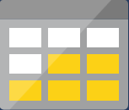

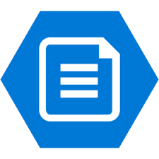
Azure storage services – Azure services
Azure Storage is a service that you can use to store files, messages, tables, and other types of information.
Blob storage: No restrictions on the kinds of data it can hold. Blobs are highly scalable
Disk storage: Provides disks for virtual machines, applications, and other services
File storage: Azure Files offers fully-managed file shares in the cloud
Archive storage: Storage facility for data that is rarely accessed
Notes:
Blob Storage
Azure Blob Storage is unstructured, meaning that there are no restrictions on the kinds of data it can hold. Blobs are highly scalable and apps work with blobs in much the same way as they would work with files on a disk, such as reading and writing data. Blob Storage can manage thousands of simultaneous uploads, massive amounts of video data, constantly growing log files, and can be reached from anywhere with an internet connection.
See https://azure.microsoft.com/en-us/services/storage/blobs/ for more details.
Disk storage
Disk storage provides disks for virtual machines, applications, and other services to access and use as they need, similar to how they would in on-premises scenarios. Details on pricing are available on the Managed Disks pricing page. See https://azure.microsoft.com/en-us/services/storage/disks/ for more general details.
File storage
Azure Files offers fully managed file shares in the cloud that are accessible via the industry standard Server Message Block (SMB) protocol. See https://azure.microsoft.com/en-us/services/storage/files/ for more details.
Archive storage
Archive storage provides a storage facility for data that is rarely accessed. It allows you to archive legacy data at low cost to what it would traditionally have cost to create and maintain archives. See https://azure.microsoft.com/en-us/services/storage/archive/ for more details.

Slide 24
Demo: Create Blob storage

Slide 25
Walkthrough-Create Blob storage
In this walkthrough task we will create a storage account, then create a blob storage container within that storage account, then upload a block blob, view and edit the blob file within the blob container in Azure, and then download the block blob file.
You can complete this walkthrough task by completing the steps outlined below, or you can simply read through them, depending on your available time.
Notes:
Students can just read through the tasks and get a feel for how it works or actually step through it like a lab task.
Another option could be to complete the walkthrough at the end of the module, and complete all or some of the walkthroughs in the module together at that stage, like an end of module or even end of course lab.
Prerequisites
You require need an Azure subscription to perform these steps. If you don't have one you can create one by following the steps outlined on the Create your Azure free account today webpage.
Steps
1. Sign in to the Azure portal at https://portal.azure.com
2. Select All services on the upper left hand side of the Azure Portal. In the All services filter box, type Storage Accounts. As you begin typing, the list filters based on your input. Select Storage Accounts.
3. On the Storage Accounts window that appears, if there are no storage accounts present you can select Create storage account, or if there are already storage accounts present, this option will nt be present and you can choose the option + Add.
4. Complete the Create storage account blade with the following details
Subscription=< Select your subscription >
Resource group=Select Create new, enter strac-rg1, then select OK.
Storage account name=< this must be between 3-24 characters in length, can be numbers and lowercase only, and must be unique across Azure >
Location=East US
Performance=Standard
Account kind=Leave the default value StorageV2 (general purpose v2)*
Replication=Locally redundant storage (LRS) Access tier (default) Hot
5. Select Review + Create to review your storage account settings and allow Azure to validate the configuration. Once validated select Create.
6. Verify its successful creation by going to the resource group just created and locate the storage account.
7. Open the storage account and scroll in the left menu for the storage account, scroll to the Blob service section, select Blobs and then select the + Container button.
8. Configure the blob container as belwo and select OK when complete to create the blob container.
Setting Value Name i.e. blob1 The container name must be lowercase, must start with a letter or number, and can include only letters, numbers, and the dash (-) character. public access level leave the default value i.e. The default level is Private (no anonymous access)
9. The container should be created and available
10. We will upload a block blob to your new container. Select the container to show a list of blobs it contains. Since this container is new, it won't yet contain any blobs
Note: Block blobs consist of blocks of data assembled to make a blob. Most scenarios using Blob storage employ block blobs. Block blobs are ideal for storing text and binary data in the cloud, like files, images, and videos.
11. Create a .txt file on your local machine, named blob1.txt, and enter some text into it, such as this is a blob file or something like that.
12. Select the Upload button to upload a blob to the container. Browse your local file system to find the file you created in the previous steps to upload as a block blob, Click on the Advanced arrow, leave the default values as they are, just note them, and then select Upload.
Note: You can upload as many blobs as you like in this way. You'll see that the new blobs are now listed within the container.
13. View the uploaded block blob by right clicking on the blob file that was uploaded and selecting View/edit blob
14. You can download a block blob by right clicking on the block blob and selecting Download. The blob file opens in a browser and is then downloadable by right clicking on the file and selecting save as
Congratulations! You have created a storage account, created a blob storage container within that storage account, then uploaded a block bob, viewed and edited the block blob in the blob container and then downloaded the block blob.
Note: Remember to remove any newly created Azure resources that you no longer use. Removing unused resources ensures you will not incur unexpected costs. Remove unused resources by deleting the Resource Group that the unused resources belong to.

Slide 26

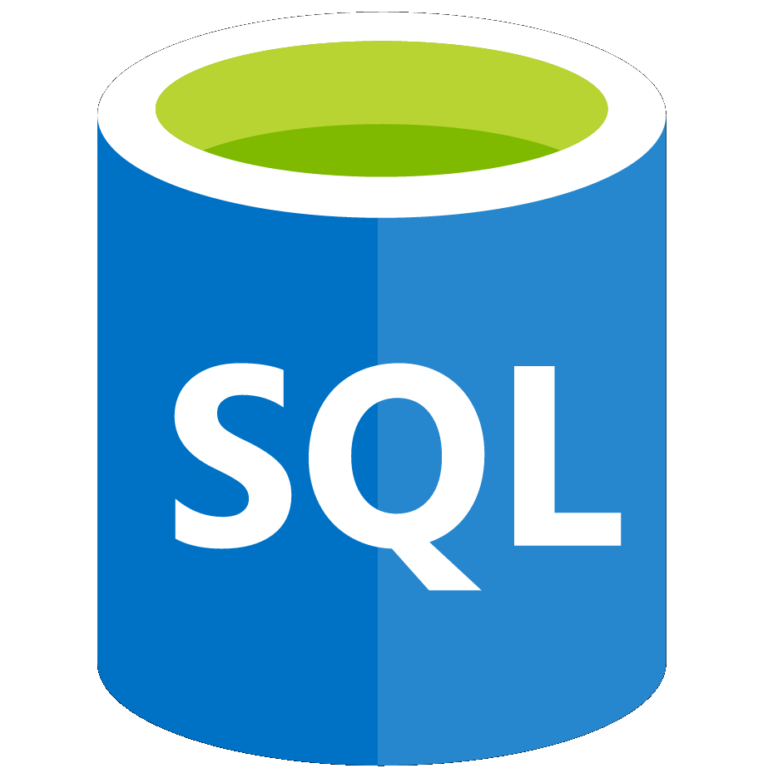
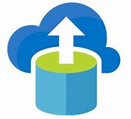
Azure database services
Azure database services are fully-managed PaaS database services that free up valuable time you’d otherwise spend managing your database
Azure Cosmos DB: A globally-distributed database service that enables you to elastically and independently scale throughput and storage
Azure SQL Database: A relational database as a service (DaaS) based on the latest stable version of the Microsoft SQL Server database engine
Azure Database Migration: A fully-managed service designed to enable seamless migrations from multiple database sources to Azure data platforms with minimal downtime
Notes:
Azure Cosmos DB
Azure Cosmos DB is a globally distributed database service that enables you to elastically and independently scale throughput and storage across any number of Azure's geographic regions. See https://azure.microsoft.com/en-us/services/cosmos-db/ for more details.
Azure SQL Database
Azure SQL Database is a relational database as a service (DaaS) based on the latest stable version of the Microsoft SQL Server database engine. SQL Database is a high-performance, reliable, fully managed and secure database. See https://azure.microsoft.com/en-us/services/sql-database/ for more details.
Azure Database Migration Service
The Azure Database Migration Service is a fully managed service designed to enable seamless migrations from multiple database sources to Azure data platforms with minimal downtime (online migrations). See https://azure.microsoft.com/en-us/services/database-migration/ for more details.
For a full list of data services available with Azure, and context on when you use them, see https://azure.microsoft.com/en-us/product-categories/databases/

Slide 27
Walkthrough-Create a SQL database
In this walkthrough task we will create a SQL database in Azure and then query the data in that database.
You can complete this walkthrough task by completing the steps outlined below, or you can simply read through them, depending on your available time
Notes:
Students can just read through the tasks and get a feel for how it works or actually step through it like a lab task.
Another option could be to complete the walkthrough at the end of the module, and complete all or some of the walkthroughs in the module together at that stage, like an end of module or even end of course lab.
Prerequisites
You require need an Azure subscription to perform these steps. If you don't have one you can create one by following the steps outlined on the Create your Azure free account today webpage.
Steps
1. Sign in to the Azure portal at https://portal.azure.com
2. Select Create a resource on the upper left hand side of the Azure Portal. Select Databases > SQL Databases and in the SQL Database pane fill in the fields as per the below table, and then click Server
Database name=db1
Subscription=< Select your subscription >
Resource group=Select Create new, enter sqldb1-rg1, then select OK.
Select source=Select Sample AdventureWorksLT
3. In the Server pane, choose Create a new server and complete the New server pane using below details and click Select when finished.
Setting Value Server name < this needs to be a unique name > Server admin login azureuser Password Enter a password that meets the complexity requirements. Location East US
4. On the Storage Accounts window that appears, if there are no storage accounts present you can select Create storage account, or if there are already storage accounts present, this option will nt be present and you can choose the option + Add.
5. On the SQL Database pane , select Pricing tier. Explore the amount of DTUs and storage available for each service tier.
Note: This database uses the DTU-based purchasing model, but there is another, the vCore-based purchasing model, which is also available.
6. Select the Standard service tier, and then use the slider to select 10 DTUs (S0) and 1 GB of storage and select Apply.
7. Click Create to deploy and provision the resource group, server, and database. It can take approx 2 to 5 minutes to deploy.
8. Once complete verify the successful deployment by going to the resource group you just created in the Azure Portal and verifying the presence of the server and database.
9. Open the SQL database you crated db1, go to the Query Editor (preview) in the left hand pane, and enter the login details and password. then click OK
10. Once you log in successfully the query pane appears, enter the following query into the editor pane
SELECT TOP 20 pc.Name as CategoryName, p.name as ProductName FROM SalesLT.ProductCategory pc JOIN SalesLT.Product p ON pc.productcategoryid = p.productcategoryid;
11. Select Run*, and then review the query results in the Results pane. The query should run successfully.
Congratulations! You have created a SQL database in Azure and successfully queried the data in that database.
Note: Remember to remove any newly created Azure resources that you no longer use. Removing unused resources ensures you will not incur unexpected costs. Remove unused resources by deleting the Resource Group that the unused resources belong to.

Slide 28
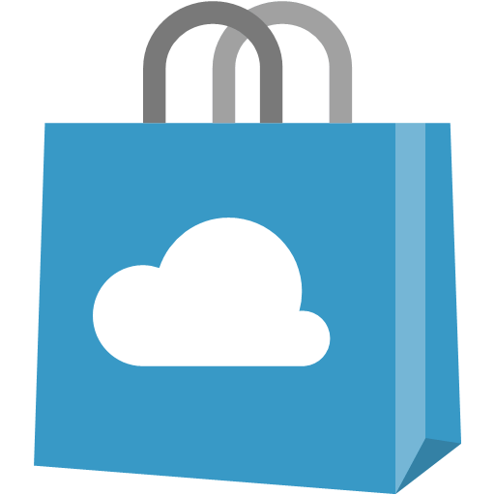
Azure Marketplace
Connects end users with Microsoft partners, Independent Software Vendors (ISVs), and start-ups that offer solutions and services for Azure.
Azure customers, IT professionals and cloud developers can find, try, purchase, and provision Azure applications and services from certified service providers.
Includes close to 10,000 product listings.
Notes:
There is also a Marketplace FAQ available at https://azure.microsoft.com/en-us/marketplace/faq/
You should go to the Azure Marketplace at Azure Marketplace services online at https://azuremarketplace.microsoft.com/en-us/ or also access via the Azure Portal

Slide 29
Lesson 04: Azure solutions

Slide 30

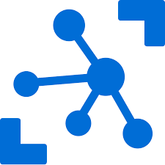
Internet of Things
The internet allows any item that's online-capable to access valuable information. This ability for devices to garner and then relay information for data analysis is referred to as the Internet of Things (IoT)
Microsoft IoT Central: A fully-managed global IoT software as a service (SaaS) solution that makes it easy to connect, monitor, and manage your IoT assets at scale
Azure IoT Hub: A managed service hosted in the cloud that acts as a central message hub for bidirectional communication between your IoT application and the devices it manages
Notes:
IoT Central
Microsoft IoT Central is a fully managed global Internet of Things (IoT) software as a service (SaaS) solution that makes it easy to connect, monitor, and manage your IoT assets at scale. No cloud expertise is required to use IoT Central. As a result, you can bring your connected products to market faster while staying focused on your customers. See https://docs.microsoft.com/en-us/azure/iot-central/ for more details.
Azure IoT Hub
Azure IoT Hub is a managed service hosted in the cloud that acts as a central message hub for bi-directional communication between your IoT application and the devices it manages. You can use Azure IoT Hub to build IoT solutions with reliable and secure communications between millions of IoT devices and a cloud-hosted solution backend. You can connect virtually any device to your IoT Hub. https://docs.microsoft.com/en-us/azure/iot-hub/
For a full list of IoT-related services available with Azure, and for context on when you use them, see the page https://azure.microsoft.com/en-us/overview/iot/

Slide 31
Demo: Add IoT device to Azure IoT Hub

Slide 32
Walkthrough-Add IoT device to Azure IoT Hub
In this walkthrough you will set up a new Azure IoT Hub in Azure Portal, and configure the hub to authenticate a connection to an IoT device using the online Raspberry Pi device simulator. Sensor data and messages are passed from the Raspberry Pi simulator to your Azure IoT Hub, and you view metrics for the messaging activity in Azure Portal.
You can complete this walkthrough task by completing the steps outlined below, or you can simply read through them, depending on your available time
Notes:
Students can just read through the tasks and get a feel for how it works or actually step through it like a lab task.
Another option could be to complete the walkthrough at the end of the module, and complete all or some of the walkthroughs in the module together at that stage, like an end of module or even end of course lab.
Prerequisites
An active Azure subscription is required. If you do not have an Azure subscription, create a free Azure account before you begin.
Steps
1. To create a new Azure IoT Hub, select the Deploy to Azure button to go to the url https://portal.azure.com/#create/microsoft.iothub and sign into Azure Portal, when prompted.
2. Fill in the fields with the following details.
Subscription: Select the subscription to use for your new Azure IoT Hub.
Resource Group: Choose Create new and provide a name for the resource group.
Region: Select the Azure region that is closest to your location from the dropdown list.
IoT Hub Name: Put in a name for your Azure IoT Hub. This name must be unique to your chosen region. If the name you enter is available, a green check mark appears.
Select the Next: Size and scale button to continue.
3. On the Size and scale tab, use the dropdown list to set the Pricing and scale tier to F1 - Free tier.
Leave all other options set to their defaults.
Select the Review + create button at the bottom.
4. Review your choices on the Review + create tab, then select the Create button to begin creating your new Azure IoT Hub.
Note: When the deployment starts, a notification appears in Azure Portal indicating the deployment is in progress. Another notification is displayed when the deployment has completed successfully.
5. When the deployment has completed, choose Go to resource from the notification area to open the Azure IoT Hub Overview blade. You can also select All resources from the main menu, then choose your Azure IoT Hub from the list of resources.
6. To add a new IoT device, select Explorers > IoT Devices from the IoT Hub navigation blade. Then, choose the + Add button.
7. Provide a name for your new IoT device, for example myDeviceId, and select the Save button. This will create a new IoT device identity in your Azure IoT Hub.
8. After the new device is created, select the new device from the list of IoT devices in the IoT devices pane. Copy the Connection string—primary key value. You will use this key in Step 10 to authenticate a connection to a Raspberry Pi device.
9. In a web browser, open the online Raspberry Pi simulator at https://azure-samples.github.io/raspberry-pi-web-simulator/#Getstarted . Select “X” to close the Overview of Raspberry Pi Simulator window or choose Next to step through the guide.
10. In the coding area, make sure that you are working on the default, Microsoft sample code. Replace the placeholder code on Line 15 with the Azure IoT Hub connection string value that you copied from Step 8. Copy over the text that is present, including the brackets.
11. Select Run or type npm start to run the application. The console output should show the sensor data and messages that are sent from the Raspberry Pi simulator to your Azure IoT Hub. Data and messages are sent each time the Raspberry Pi simulator LED flashes. Select Stop to stop sending data.
12. To view metrics for the messaging activity in Azure Portal, select All resources from the main menu. Choose your Azure IoT Hub from the list of resources. Scroll down to the IoT Hub Usage pane of the IoT Hub Overview blade. To access these metrics from the IoT Hub navigation blade, select Metrics from the Monitoring section.
Congratulations! You have set up Azure IoT Hub to collect sensor data from an IoT device.
Note: Remember to remove any newly created Azure resources that you no longer use. Removing unused resources ensures you will not incur unexpected costs. Remove unused resources by deleting the Resource Group that the unused resources belong to.

Slide 33
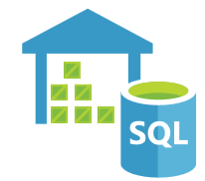

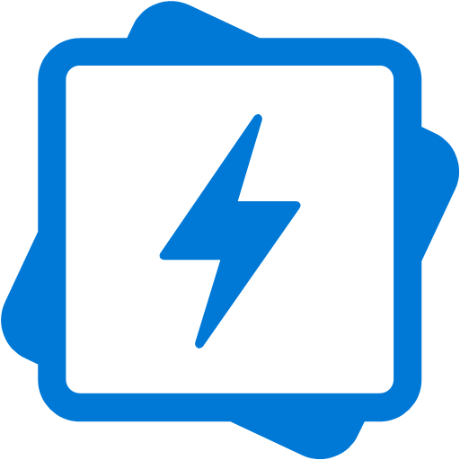
Big data and analytics
Big data refers to large volumes of data that become increasingly hard to make sense of, or consequently make decisions about. Some big data and analytic services in Azure include:
Azure SQL Data Warehouse: A cloud-based Enterprise Data Warehouse that leverages massively parallel processing (mpp) to run complex queries quickly across petabytes of data
Azure HDInsight: A fully-managed, open-source analytics service for enterprises. It is a cloud service that makes it easier, faster, and more cost-effective to process massive amounts of data
Azure Data Lake Analytics: An on-demand analytics job service that simplifies big data. Instead of deploying and tuning hardware, you write queries to transform your data and extract valuable insights.
Notes:
Azure SQL Data Warehouse
Azure SQL Data Warehouse is a cloud-based enterprise data warehouse that leverages massively parallel processing (MPP) to run complex queries quickly across petabytes of data.. See https://azure.microsoft.com/en-us/services/sql-data-warehouse/ for more details.
Azure HDInsight
Azure HDInsight is a fully managed, open-source analytics service for enterprises. It is a cloud service that makes it easier, faster, and more cost-effective to process massive amounts of data. HDInsight allows you run popular open-source frameworks and create cluster types such as Apache Spark, Apache Hadoop, Apache Kafka, Apache HBase, Apache Storm, Machine Learning Services. See https://azure.microsoft.com/en-us/services/hdinsight/ for more general details.
Azure Data Lake Analytics
Azure Data Lake Analytics is an on-demand analytics job service that simplifies big data. Instead of deploying, configuring, and tuning hardware, you write queries to transform your data and extract valuable insights.. See https://azure.microsoft.com/en-us/services/data-lake-analytics/ for more details.
For a full list of Big Data and Analytics services available with Azure, and for context on when you use them, visit https://azure.microsoft.com/en-us/product-categories/analytics/

Slide 34


Artificial Intelligence
Artificial Intelligence (AI), in the context of cloud computing, is based around a broad range of applications, including Machine Learning, which use existing data to forecast future behaviors, outcomes, and trends. Using machine learning, computers learn without being explicitly programmed. Some AI services in Azure include:
Azure Machine Learning service: Provides a cloud-based environment used to develop, train, test, deploy, manage, and track machine learning models
Azure Machine Learning Studio: A collaborative, drag-and-drop visual workspace where you can build, test, and deploy machine learning solutions without needing to write code
Notes:
Azure Machine Learning Service
Azure Machine Learning service provides a cloud-based environment you can use to develop, train, test, deploy, manage, and track machine learning models. Azure Machine Learning service can auto-generate a model and auto-tune it for you. It will let you start training on your local machine, and then scale out to the cloud. When you have the right model, you can easily deploy it in a container such as Docker in Azure. See https://azure.microsoft.com/en-us/services/machine-learning-service/ for more details.
Azure Machine Learning Studio
Azure Machine Learning Studio is a collaborative, drag-and-drop visual workspace where you can build, test, and deploy machine learning solutions without needing to write code. It uses pre-built and pre-configured machine learning algorithms and data-handling modules. Use Machine Learning Studio when you want to experiment with machine learning models quickly and easily, and the built-in machine learning algorithms are sufficient for your solutions. It does not provide as much control over machine learning algorithms as the Machine Learning Service we discussed earlier. See https://azure.microsoft.com/en-us/services/machine-learning-studio/ for more general details.
Note: For a full list of Artificial Intelligence and Machine Learning services available with Azure, see the AI + Machine Learning section on the https://azure.microsoft.com/en-us/overview/ai-platform/ page.

Slide 35
Serverless computing
Serverless computing is a cloud-hosted execution environment that runs your code but abstracts the underlying hosting environment. Some serverless services in Azure include:
Azure Functions: Concerned with the code running your service and not the underlying platform or infrastructure. Creates infrastructure based on an event.
Azure Logic Apps: A cloud service that helps you automate and orchestrate tasks, business processes, and workflows when you need to integrate apps, data, systems, and services across enterprises or organizations.
Azure Event Grid: A fully-managed, intelligent event routing service that uses a publish-subscribe model for uniform event consumption.
Notes:
Azure Functions
Azure Functions are ideal when you're only concerned with the code running your service and not the underlying platform or infrastructure. Azure Functions are commonly used when you need to perform work in response to an event—often via a REST request, timer, or message from another Azure service—and when that work can be completed quickly, within seconds or less. Seehttps://docs.microsoft.com/en-us/azure/azure-functions/ for more details.
Azure Logic Apps
Azure Logic Apps is a cloud service that helps you automate and orchestrate tasks, business processes, and workflows when you need to integrate apps, data, systems, and services across enterprises or organizations. Logic Apps simplifies how you design and build scalable solutions. See https://docs.microsoft.com/en-us/azure/logic-apps/ for more details.
Azure Event Grid
Azure Event Grid allows you to easily build applications with event-based architectures. It's a fully-managed, intelligent event routing service that uses a publish-subscribe model for uniform event consumption. See https://docs.microsoft.com/en-us/azure/event-grid/ for more details.
Note: For more details about serverless services available with Azure, see https://azure.microsoft.com/en-us/solutions/serverless/

Slide 36
Demo: Run serverless code with Azure Functions in Azure portal

Slide 37
Walkthrough-Run serverless code with Azure Functions in Azure portal
In this walkthrough you will write and run serverless code inside an Azure Function App in Azure portal.
You can complete this walkthrough task by completing the steps outlined below, or you can simply read through them, depending on your available time
Notes:
Students can just read through the tasks and get a feel for how it works or actually step through it like a lab task.
Another option could be to complete the walkthrough at the end of the module, and complete all or some of the walkthroughs in the module together at that stage, like an end of module or even end of course lab.
Prerequisites
An active Azure subscription is required. If you do not have an Azure subscription, create a free Azure account before you begin.
Steps
1. To create a new Azure Function App, select the Deploy to Azure button. Sign into Azure Portal, when prompted.
2. Fill in the Azure Function App settings fields with the following details.
App name: Provide a unique name that identifies your new Function App.
Subscription: Select an Azure subscription for your Function App.
Resource Group: Choose Create new. Provide a unique name for your new Resource Group, if Azure has not provided a name automatically.
OS: Select Windows. For Linux hosting, see Create your first function running on Linux using the Azure CLI at https://docs.microsoft.com/en-us/azure/azure-functions/functions-create-first-azure-function-azure-cli-linux
Hosting plan: Choose Consumption plan. With Azure serverless hosting, you only pay for the time that your functions run. Using the default Consumption Plan means that resources are added dynamically as required by your functions.
Location: Choose the Azure region that is closest to your location.
Runtime stack: Select .NET (this is suitable for running C# and F# functions).
Storage: Choose Create new. Provide a unique name for your new storage account, if Azure has not provided a name automatically.
Application Insights: Leave this set to the default value, provided by Azure automatically.
3. Select the Create button to begin provisioning and deploying your new Azure Function App.
Note: When the deployment starts, a notification appears in Azure Portal indicating the deployment is in progress. Another notification is displayed when the deployment has completed successfully.
4. When the deployment has completed, choose Go to resource from the notification area to view your new Azure Function App. You can also select All resources from the main Azure menu, then choose your Azure Function App from the list of resources.
5. To create an HTTP Triggered Function, use the down arrow icon to expand your Azure Function App. Select the “+” button next to Functions. Choose In-portal, and select Continue.
6. Choose WebHook + API, and then select Create.
7. Select </> Get function URL from the within the function editor. Set the Key value to default (Function key) using the dropdown. Then, select Copy to copy the function URL.
8. Paste the copied function URL into your web browser's address bar. Append &name=<yourname> to the end of the URL.
Note: Here, <yourname> refers to your given first name. Navigate to the URL to see the “Hello” message, followed by the name you provided, displayed in your browser. The URL should be similar to https://azfuncek01.azurewebsites.net/api/HttpTrigger1?code=X9xx9999xXXXXX9x9xxxXX==&name=glen
9. When your function runs, trace information is written to log files in Azure. To view the logs in Azure portal, return to the function editor, and select the Logs button.
Congratulations! You have written and run serverless code inside an Azure Function App, in Azure portal, successfully.
Note: Remember to remove any newly created Azure resources that you no longer use. Removing unused resources ensures you will not incur unexpected costs. Remove unused resources by deleting the Resource Group that the unused resources belong to.

Slide 38

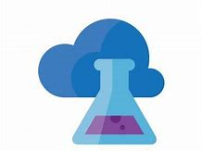
DevOps
DevOps allows you to create build and release pipelines that provide continuous integration, delivery, and deployment for applications.
Azure DevOps services: Provides development collaboration tools including pipelines, Git repositories, Kanban boards, and extensive automated and cloud-based load testing.
Azure DevTest Labs: Allows you to quickly create environments in Azure while minimizing waste and controlling cost
Notes:
Azure DevOps Services
Azure DevOps Services (formerly known as Visual Studio Team Services (VSTS)), provides development collaboration tools including high-performance pipelines, free private Git repositories, configurable Kanban boards, and extensive automated and cloud-based load testing. See https://docs.microsoft.com/en-us/azure/devops/ for more details.
Azure DevTest Labs
Azure DevTest Labs is a service that helps developers and testers quickly create environments in Azure while minimizing waste and controlling cost. Users can test their latest application versions by quickly provisioning Windows and Linux environments using reusable templates and artifacts. See https://azure.microsoft.com/en-us/services/devtest-lab/ for more general details.
Note: For more general details on DevOps services available with Azure, see https://docs.microsoft.com/en-us/azure/#pivot=products&panel=devops

Slide 39
Lesson 05: Azure management solutions

Slide 40
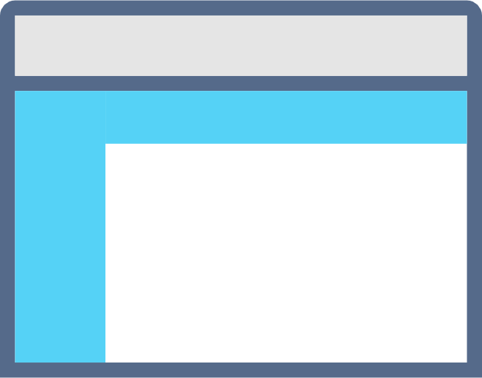
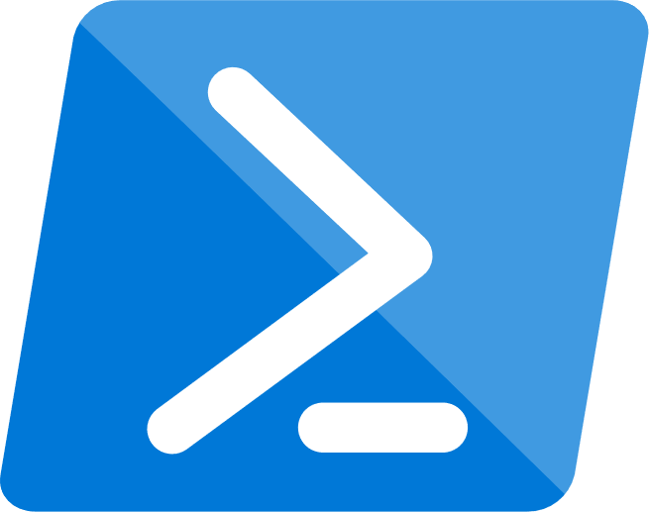
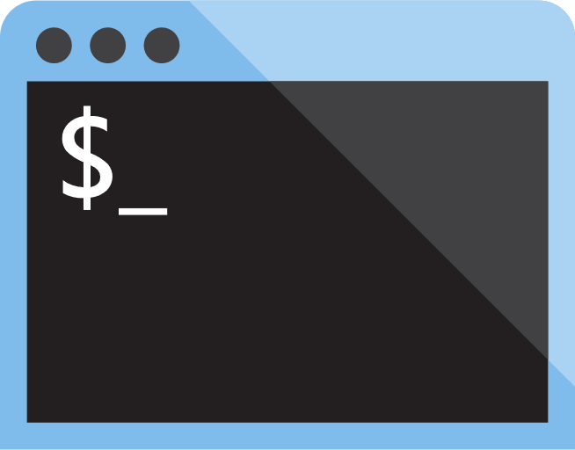

Azure management tools
Configure and manage Azure using a broad range of tools and platforms.
Azure management tools include:
Azure Portal : Management website accessed via a web browser.
Azure PowerShell : Command shell scripting language.
Azure Command-Line Interface (CLI) : Cross-platform, command-line scripting program for Windows, Linux, or MacOS.
Azure Cloud Shell : Browser-based scripting environment.
Notes:
You may provide more detail using the information below. If you’ve time, consider showing students the tools and the URLs for accessing them (where applicable).
Azure Portal - https://portal.azure.com
Azure PowerShell - A module added to Windows PowerShell or PowerShell Core for connecting to your Azure subscription and managing Azure resources.
Azure CLI - A cross-platform, command-line program that connects to Azure and executes administrative commands on Azure resources.
Azure Cloud Shell - A browser-based scripting environment in Azure portal. It provides flexibility by allowing you to choose your preferred shell experience. Linux users can opt for a Bash experience, and Windows users can opt for PowerShell. Access Azure Cloud Shell from : https://shell.azure.com/
You can also use Azure SDKs, in a range of languages, and REST APIs to configure Azure. For a list Azure management tools, see : https://azure.microsoft.com/en-us/downloads/

Slide 41
Demo: Customize the Azure Portal

Slide 42
Walkthrough-Working with the Azure CLI
In this walkthrough task we will install the Azure CLI on our local machine, then create a virtual machine using the Azure CLI and an Azure Resource Manager template, then verified that deployment using the Azure CLI in the Azure Cloud Shell
You can complete this walkthrough task by completing the steps outlined below, or you can simply read through them, depending on your available time
Notes:
Students can just read through the tasks and get a feel for how it works or actually step through it like a lab task.
Another option could be to complete the walkthrough at the end of the module, and complete all or some of the walkthroughs in the module together at that stage, like an end of module or even end of course lab.
Prerequisites
You require need an Azure subscription to perform these steps. If you don't have one you can create one by following the steps outlined on the Create your Azure free account today webpage.
A local environment is also needed such as a Windows, Linux or MacOS
Note: The following steps are based on a Windows installation, however they could equally be applicable to a mac or linux environment. However there are specific installation steps for each environment. To see the installation steps for your particular environment see the Install the Azure CLI page.
Steps
We will install Azure CLI on the Windows operating system using the MSI installer:
1. To download the Azure CLI msi, click on the URL https://aka.ms/installazurecliwindows, and in the browser, select to Run.
2. In the installation wizard, accept the license terms, and then click Install.
3. In the User Account Control dialog, select Yes.
4. Once successfully installed, the Azure CLI is run by opening a Bash shell for Linux or macOS, or from the command prompt or PowerShell for Windows. Open a command prompt as administrator.
5. Login to your Azure subscription by running the below command and following the prompts
az login
6. Verify your installation by running the version check command and ensuring it runs successfully:
az --version
Note: Running Azure CLI from PowerShell has some advantages over running Azure CLI from the Windows command prompt. PowerShell provides more tab completion features than the command prompt.
7. Create a resource group to deploy your resources to, by running the following command:
az group create --name < resource group name > --location < your nearest datacenter >
8. We will now deploy a virtual machine and configure it using an Azure Resource Manager template. The template is available on GitHub at the location https://raw.githubusercontent.com/Azure/azure-quickstart-templates/master/101-vm-simple-windows/azuredeploy.json, and we will call the script using an Azure CLI command and some other parameters.
9. Before deploying we will validate the template and command by running the following Azure CLI command, substituting the values with your own, specifying a username and password and a unique name for the virtual machine DNS label prefix value. The command should run successfully without error, identify what is causing the error, modify it and run the command again until it does validate successfully.
az group deployment validate `
--resource-group < resource group created earlier > `
--template-uri https://raw.githubusercontent.com/Azure/azure-quickstart-templates/master/101-vm-simple-windows/azuredeploy.json `
--parameters adminUsername=$USERNAME `
--parameters adminPassword=$PASSWORD `
--parameters dnsLabelPrefix=$DNS_LABEL_PREFIX
10. Deploy the resource by running the following command, substituting the same values as earlier:
az group deployment create `
--name MyDeployment `
--resource-group <rgn>[sandbox resource group name]</rgn> `
--template-uri https://raw.githubusercontent.com/Azure/azure-quickstart-templates/master/101-vm-simple-windows/azuredeploy.json `
--parameters adminUsername=$USERNAME `
--parameters adminPassword=$PASSWORD `
--parameters dnsLabelPrefix=$DNS_LABEL_PREFIX
11. Verify the deployment by signing into the Azure portal at https://portal.azure.com
12. Go to the resource group you created and verify the virtual machine and resources are present, note the name of the virtual machine is SimpleWinVM
13. It is also possible to use the Azure CLI with the Azure Cloud Shell. The Azure Cloud Shell has the Azure CLI already installed. Open the Azure Cloud Shell by clicking on the Azure Cloud Shell icon in the top right of the Azure Portal.
14. The browser becomes split and the Azure cloud Shell opens in the bottom half of your existing browser and you are prompted to select between Bash or PowerShell, select Bash
15. You are prompted to create storage, select Create storage, and allow the Azure Cloud Shell to initialize. You do not need to sign into the Azure Clod Shell, it does this automatically for you.
16. Obtain a list of the virtual machines present in your subscription, and display only the resource group and virtual machine name by running the command:
az vm list --query [].[resourceGroup,name] --out tsv
Congratulations! You have installed the Azure CLI on your local machine, created a virtual machine using the Azure CLI and an Azure Resource Manager template, then verified that deployment using the Azure CLI in the Azure Cloud Shell.
Note: Don't forget to delete any resources you deployed to avoid incurring additional costs from them.

Slide 43
Demo: Create VMs from a script with Azure PowerShell

Slide 44
Walkthrough-Create VMs from a script with Azure PowerShell
In this walkthrough you will write and run a local PowerShell script. The PowerShell script uses the Azure PowerShell module to create three virtual machines (VMs) in Azure from a Linux Ubuntu image.
You can complete this walkthrough task by completing the steps outlined below, or you can simply read through them, depending on your available time
Notes:
Students can just read through the tasks and get a feel for how it works or actually step through it like a lab task.
Another option could be to complete the walkthrough at the end of the module, and complete all or some of the walkthroughs in the module together at that stage, like an end of module or even end of course lab.
Prerequisites
An active Azure subscription is required. If you do not have an Azure subscription, create a free Azure account before you begin.
Installing the Azure PowerShell module requires Windows PowerShell 5.1 or higher on Windows, or PowerShell Core 6.0 on Windows, Linux, macOS and ARM. Follow these instructions for Installing various versions of PowerShell on your local machine at https://docs.microsoft.com/en-us/powershell/scripting/install/installing-powershell?view=powershell-6
You must have a text editor installed to write a new PowerShell script. You could use the PowerShell Integrated Scripting Environment (ISE) or another option could be to use Visual Studio Code.
Steps
1. Open a text editor. Make a new file, and add the following code into the new file. The comments explain each of the commands within the script file.
# capture the input parameter in a variable
param([string]$resourceGroup)
# prompt for a username and password for the VMs admin account
# and capture the result in a variable $adminCredential = Get-Credential -Message "Enter a username and password for the VM administrator."
# Add a loop that executes three times to create a new VM for each loop iteration For ($i = 1; $i -le 3; $i++) { # create a name for each VM, store it in a variable and output it to the console $vmName = "AzDemo" + $i Write-Host "Creating VM: " $vmName # create a VM using the $vmName variable New-AzVm -ResourceGroupName $resourceGroup -Name $vmName -Credential $adminCredential -Image UbuntuLTS }
2. Save the new file as azdemo.ps1. Make a note of the directory location where you save the script file, you will be required to recall the directory location in Step 6.
3. Open a new PowerShell session with elevated privileges.
Windows: Select the Start icon from the task bar. Type PowerShell. Right select the Windows PowerShell Desktop App icon. Choose Run as administrator.
Linux and macOS: In a terminal, launch PowerShell Core with elevated privileges using the following command.
sudo pwsh
4. At the PowerShell prompt, install the Azure PowerShell module (Az) by running the following command.
Install-Module Az -AllowClobber
Answer Yes or Yes to All, if prompted, to trust the Az module.
Note: Windows users should agree to install the NuGet provider, and agree to install modules from the PowerShell Gallery (PSGallery), if prompted. If you receive script execution failures, run Set-ExecutionPolicy RemoteSigned in an elevated PowerShell session. Running the command will unrestricted your execution policy, and allow you to install and run modules from the PSGallery.
5. Update the Az module by running the following command.
Update-Module -Name Az
Answer Yes or Yes to All, if prompted, to trust updates to the Az module. If you already have the latest version of the Az module installed, the prompt will be returned automatically.
6. Use the cd command to change into the directory that contains the PowerShell script file azdemo.ps1 that you created in Step 1. Replace <scriptsdir> with the actual directory where you saved the script file.
cd C:\<scriptsdir>
7. Sign into Azure by running the following command. When prompted, provide your Azure login credentials and select the sign in button.
Connect-AzAccount
Note: The following Step 8 assumes that you have a single Azure subscription associated with your Azure account. If you have multiple subscriptions, you can get a list of your subscriptions using the command Get-AzSubscription. Specify which subscription to use with the command Select-AzSubscription -Subscription "<Name of your subscription>". Substitute the actual name of the subscription you want to use for <Name of your subscription>.
8. Create a new resource group using the following command.
New-AzResourceGroup -Name <name> -Location <location>
Replace <name> with a suitable name for the new resource group. For example, AzDemo. Add a value for <location> that corresponds to the Azure region closest to you. For example, northeurope.
9. Execute the azdemo.ps1 script by running the following command. Substitute the name of the resource group that you created in the previous Step 8 for <resource group name>.
.\azdemo.ps1 <resource group name>
10. When prompted, provide a username and password for the VM administrator, and select ok. For example, for the User name enter azdemoadmin and for the Password enter pa$$W0rd101.
11. The script will begin creating the Azure resources required by each VM, and may take several minutes to complete. Wait for the script to finish before you go to Step 12.
12. When the script is finished, verify that it ran successfully by looking at the resources listed in the resource group that you created in Step 8. When you run the following command you should see three VMs, each with a unique name.
Get-AzResource -ResourceType Microsoft.Compute/virtualMachines
13. The suffix AzVM is specific to VM-based commands in Azure PowerShell.
14. When you are finished, use the following Azure PowerShell command to delete the resource group and all the resources within it.
Remove-AzResourceGroup -Name <Resource group name>
Substitute the name of the resource group you created in Step 8 for <resource group name>. When asked to confirm the deletion, answer Yes. The command may take several minutes to complete, and will return True when the resource group is deleted successfully.
15. Run the following command to disconnect the PowerShell session from your Azure account. Then, exit or close the PowerShell terminal window.
disconnect-AzAccount
Congratulations! You wrote and ran a local PowerShell script. The PowerShell script used the Azure PowerShell module to create three VMs in Azure from a Linux Ubuntu image.
Note: Remember to remove any newly created Azure resources that you no longer use. Removing unused resources ensures you will not incur unexpected costs. Remove unused resources by deleting the Resource Group that the unused resources belong to.

Slide 45
Demo: Install IIS webserver on a VM with Azure Cloud Shell

Slide 46
Walkthrough-Install IIS webserver on a VM with Azure Cloud Shell
In this walkthrough, you use Azure Cloud Shell to automate the installation of the Windows Internet Information Services webserver (IIS) on a new virtual machine (VM). Azure Cloud Shell creates a VM and uses the Custom Script Extension to install IIS.
You can complete this walkthrough task by completing the steps outlined below, or you can simply read through them, depending on your available time
Notes:
Students can just read through the tasks and get a feel for how it works or actually step through it like a lab task.
Another option could be to complete the walkthrough at the end of the module, and complete all or some of the walkthroughs in the module together at that stage, like an end of module or even end of course lab.
Prerequisites
An active Azure subscription is required. If you do not have an Azure subscription, create a free Azure account before you begin.
Steps
1. To access Azure Cloud Shell go to the location https://shell.azure.com and sign in with your Azure user login credentials.
You can also run Azure Cloud Shell from within Azure Portal by using the Cloud Shell icon.
2. If prompted, choose a Bash or PowerShell environment. This walkthrough uses PowerShell.
3. First time Azure Cloud Shell users must create and configure Cloud Drive storage, to allow Azure Cloud Shell files to persist. To create and configure storage, select Show advanced settings. If you have created and configured storage already, go to Step 5.
4. Provide the following details to create and configure storage.
Subscription: Choose your subscription.
Cloud Shell region: Select the location closest to you. For example, North Europe
Resource group: Choose Create new, then provide a unique name for your new resource group.
Storage account: Select Create new, and provide a unique name for your storage account.
File share: Choose Create new, then enter a unique file share name.
Select the Create storage button
Wait for the storage setup to complete. When the storage setup is complete, the Welcome to Azure Cloud Shell message is shown in the terminal window.
5. At the Azure Cloud Shell prompt, set a VM administrator username and password with the Get-Credential command. The credentials are assigned to the variable $cred. The variable is recalled when the new VM is created in the next Step 6.
$cred = Get-Credential When prompted, enter a username and password for the VM administrator. For example,
User: myVMAdmin
Password: pa$$W0rd101
6. Create a VM with the New-AzVM command. The following example creates a VM named myVM in the North Europe location. If they do not exist, the resource group myResourceGroup and supporting network resources are created in Azure. To allow web traffic, the following command also opens port 80. Change these to more suitable settings, if you prefer.
Note: Ensure you are signed into your Azure subscription. If you have multiple subscriptions, you can get a list of your subscriptions using the command Get-AzSubscription. Specify which subscription to use with the command Select-AzSubscription -Subscription "<Name of your subscription>". Substitute the actual name of the subscription you want to use for <Name of your subscription>.
New-AzVm `
-ResourceGroupName "myResourceGroup" `
-Name "myVM" `
-Location "North Europe" `
-VirtualNetworkName "myVnet" `
-SubnetName "mySubnet" `
-SecurityGroupName "myNetworkSecurityGroup" `
-PublicIpAddressName "myPublicIpAddress" `
-OpenPorts 80 `
-Credential $cred
When the newly created resources and VM are ready, details about the resources and VM will be displayed in the Azure Cloud Shell window. Wait for the resources and VM to be created.
7. Use the Set-AzVMExtension command to install the Custom Script Extension. The Custom Script Extension runs the command powershell Add-WindowsFeature Web-Server to install IIS to your new VM.
Set-AzVMExtension -ResourceGroupName "myResourceGroup" `
-ExtensionName "IIS" `
-VMName "myVM" `
-Location "North Europe" `
-Publisher Microsoft.Compute `
-ExtensionType CustomScriptExtension `
-TypeHandlerVersion 1.8 `
-SettingString '{"commandToExecute":"powershell Add-WindowsFeature Web-Server"}’
Wait for the Custom Script Extension and IIS to install. When the Custom Script Extension installs IIS successfully, IsSuccessStatusCode will return True in the Azure Cloud Shell window.
8. Obtain the public IP address of your load balancer with the Get-AzPublicIPAddress command. The following example obtains the IP address for myPublicIPAddress created in Step 4.
Get-AzPublicIPAddress `
-ResourceGroupName "myResourceGroup" `
-Name "myPublicIPAddress" | select IpAddress
9. Use a web browser to navigate to the public IP address. The Windows server IIS Welcome page should be displayed in your browser.
10. Return to Azure Cloud Shell. Run the following command to remove the resource group myResourceGroup, VM, and all related resources. Choose Yes to confirm the deletion, when prompted.
Remove-AzResourceGroup -Name myResourceGroup
Congratulations! You used Azure Cloud Shell to automate the installation of IIS on a new VM.
Note: Remember to remove any newly created Azure resources that you no longer use. Removing unused resources ensures you will not incur unexpected costs. Remove unused resources by deleting the Resource Group that the unused resources belong to.

Slide 47

Azure Advisor
Analyzes your deployed Azure resources and recommends ways to improve availability, security, performance, and costs.
With Azure Advisor, you can:
Get proactive, actionable, and personalized best practice recommendations.
Improve the performance, security, and availability of your resources.
Identify opportunities to reduce your Azure costs.
Notes:
Azure Advisor is accessible through Azure portal. After you sign into Azure portal, either (a) select Advisor from the navigation menu, or (b) search for Advisor in the All services menu.
You can download recommendations from Azure Advisor in PDF or CSV format, which you can then share.
For details about Azure Advisor, see : https://docs.microsoft.com/en-us/azure/advisor/

Slide 48
Demo: Save a recommendations report with Azure Advisor

Slide 49
Walkthrough-Save a recommendations report with Azure Advisor
In this walkthrough, you create and save a personalized recommendations report with Azure Advisor. You deploy a Virtual Machine (VM) and network resources, which Azure Advisor analyzes, to get recommendations and generate the report.
You can complete this walkthrough task by completing the steps outlined below, or you can simply read through them, depending on your available time
Notes:
Students can just read through the tasks and get a feel for how it works or actually step through it like a lab task.
Another option could be to complete the walkthrough at the end of the module, and complete all or some of the walkthroughs in the module together at that stage, like an end of module or even end of course lab.
Prerequisites
An active Azure subscription is required. If you do not have an Azure subscription, create a free Azure account before you begin.
Steps
1. Select the Deploy to Azure button to go to the url https://portal.azure.com/#create/Microsoft.Template/uri/https%3A%2F%2Fraw.githubusercontent.com%2FAzure%2Fazure-quickstart-templates%2Fmaster%2F101-vm-simple-linux%2Fazuredeploy.json
, to begin deploying a new VM to Azure from a template. Sign into the Azure Portal, when prompted. The Visualize button will bring you to the url http://armviz.io/#/?load=https%3A%2F%2Fraw.githubusercontent.com%2FAzure%2Fazure-quickstart-templates%2Fmaster%2F101-vm-simple-linux%2Fazuredeploy.json
and provide a visual representation of the deployment you will perform. This visualization is available with all template deployments to Azure and may be helpful when constructing templates and deployments to Azure to allow you view the architecture and relationships between resources.
2. Enter the following details for the new VM.
Subscription: Select your Azure subscription.
Resource group: Choose Create new, and enter a name for the new resource group. Select the ok button.
Location: Choose the Azure location that is closest to you. For example, Australia SouthEast.
Admin Username: Enter a name for the VM administrator.
Authentication Type: Select password.
Admin Password Or Key: Enter a password for the VM administrator.
DNS Label Prefix: Enter a DNS label prefix. For example, mydnsprefix
Ubuntu OS Version: Leave this at the default setting. For example, 16.04.0LTS
Location: Leave this at the default setting [resourceGroup().location]
Check the box to agree to the terms and conditions.
Select the Purchase button.
Note: When the deployment starts, a notification appears in Azure Portal indicating the deployment is in progress. Another notification is displayed when the deployment has completed successfully.
3. When the deployment has completed, choose Go to resource group from the notification area to open the Azure resource group Overview blade. You can also select Resource groups from the main Azure menu, then choose your resource group from the list.
4. Verify that the new VM and associated network resources are present in the Azure resource group Overview pane.
5. Open Advisor from the main Azure menu. The Recommendations tile under Overview, and panels, allow you to filter the recommendations identified by Azure Advisor. For example, for an overview of Security Center recommendations, select the Security panel.
Note: Azure Advisor recommendations are unique to your Azure configuration and usage history. More or less recommendations may be available, in accordance with your Azure resource configurations and usage telemetry.
6. Choose Follow Security Center Recommendations to see a list of security center recommendations applicable to your subscription.
7. Select a recommendation from the list for more information. The following example shows how to access information about applying disk encryption to VMs. Explore the other recommendations to learn about Azure Advisor.
8. To download an Azure Advisor recommendations report, return to the Azure Advisor Overview. Select Download recommendations as PDF or CSV, and save the report file.
Congratulations! You created and saved a personalized recommendations report with Azure Advisor.
Note: Remember to remove any newly created Azure resources that you no longer use. Removing unused resources ensures you will not incur unexpected costs. Remove unused resources by deleting the Resource Group that the unused resources belong to.

Slide 50
Lesson 06: Module 2 review questions

Slide 51
Module 2 review questions
What are the core architectural components of Azure?
Every resource created in Azure must exist in one and only one what?
You need to deploy a legacy application in Azure that has some customizations that are needed to ensure it runs successfully. The application will run on a VM running the Windows operating system.
Which Azure service do you recommend running the virtual machine in?
Notes:
Answers
Question 1: Region, Geography, Availability zone, Availability Set, Resource group, and Azure Resource Manager are all core architectural components of Azure.
Question 2: Resource group is the correct answer. Each resource must exist in one, and only one, resource group.
Question 3: Azure Virtual Machines is the correct answer, because it is an IaaS service and as such you are responsible for configuring and managing the virtual machine on which the application will run. This enables you to customize it as needed in this case.

